Slide 1
Lesson objective
Need calculators.
PBiS focus: EMPATHY
- Accept and understand differences
Title: data comparison
Aim – be able to:
Represent comparative data in back-to-back stem and leaf diagrams
Compare central tendencies of data sets
Plan:
Averages from stem and leaf
B2B stem and leaf
Outliers and comparisons of data

Slide 2
Ages of teachers
2 | 2 | 4 | 7 | 9
3 | 1 | 2 | 5 | 5 | 7 | 9
4 | 0 | 4 | 4 | 7
5 | 2 | 7 | 9
Key 36 years = 3⏐6
Range = 59 – 22 = 37
Find the range of ages.
Find the modal age.
Find the median age.
Modal value = 35 and 44
17 numbers :–
Median = ( 17 + 1 ) ÷ 2 = 9th value
Median = 37

Slide 3
When comparing two sets of data, it can be useful to draw a back-to-back stem and leaf diagram
Back-to-Back stem and leaf diagrams share the same ‘stem’
Numbers closest to the ‘stem’ are smaller

Slide 4
Ages of teachers
Female Data:
22 24 27 29 31 32 35 35 37
39 40 44 44 47 52 57 59
Male data:
23 27 30 31 32 36 39 42 43
45 47 48 48 50 51 52 59
Males
Females
 |  |  |  |  |  | 2
 |  |  |  |  |  | 3
 |  |  |  |  |  | 4
 |  |  |  |  |  | 5

Slide 5
Males
Females
 |  |  |  | 7 | 3 | 2 | 2 | 4 | 7 | 9
 | 9 | 6 | 2 | 1 | 0 | 3 | 1 | 2 | 5 | 5 | 7 | 9
8 | 8 | 7 | 5 | 3 | 2 | 4 | 0 | 4 | 4 | 7
 |  | 9 | 2 | 1 | 0 | 5 | 2 | 7 | 9
Key 36 years = 6⏐3
Key 36 years = 3⏐6
Compare the age of the males and females
 | Mode | Median | Range
Males
Females
48
43
36
35 and 44
37
37
Write a sentence for each column.

Slide 6
Heights of students
Female Data:
142 144 147 151 152 156 157
157 160 165 168 169 175
Male data:
146 150 153 155 159 161 163 164
167 167 168 170 172 172 179
Males
Females
 |  |  |  |  |  | 14
 |  |  |  |  |  | 15
 |  |  |  |  |  | 16
 |  |  |  |  |  | 17

Slide 7
Males
Females
 |  |  |  |  | 6 | 14 | 2 | 4 | 7
 |  | 9 | 5 | 3 | 0 | 15 | 1 | 2 | 6 | 7 | 7
8 | 7 | 7 | 4 | 3 | 1 | 16 | 0 | 5 | 8 | 9
 |  | 9 | 2 | 2 | 0 | 17 | 5
Key 146 cm = 6⏐14
Key 146 cm = 14⏐6
Compare the heights of the males and females
 | Mode | Median | Range
Males
Females
167and 157
164 cm
33 cm
157 cm
157 cm
33 cm
Write a sentence for each column.

Slide 8
Key:
3 | 2 means 23 mph
Key:
2 | 3 means 23 mph
 |  |  |  |  |  |  | 2 | 3 | 4 | 4 | 4 | 6 | 7 | 8 | 8
9 | 8 | 6 | 5 | 4 | 2 | 0 | 3 | 0 | 0 | 1 | 2 | 5 | 7
 | 6 | 4 | 4 | 4 | 3 | 1 | 4 | 0
ROAD 1
ROAD 2
The above presented data is the speed of cars on two different roads.
Complete the following table
 | Mode | Median | Range
Road 1
Road 2
44
39
16
24
28
17
Write a sentence about each road.

Slide 9
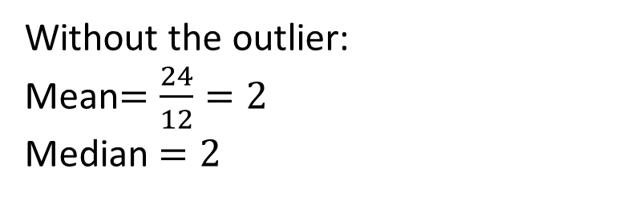
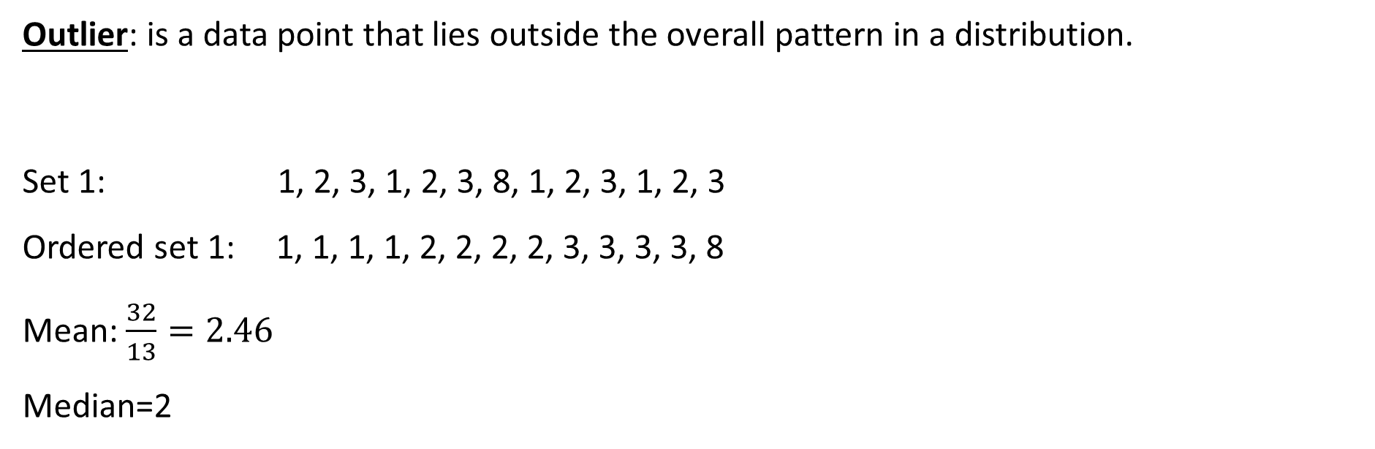
Outlier: is a data point that lies outside the overall pattern in a distribution.
Set 1: 1, 2, 3, 1, 2, 3, 8, 1, 2, 3, 1, 2, 3
Ordered set 1: 1, 1, 1, 1, 2, 2, 2, 2, 3, 3, 3, 3, 8
Mean: $\frac{32}{13}=2.46$
Median=2
Without the outlier:
Mean$=\frac{24}{12}=2$
Median $=2$
Which average is effected more by the outlier?
The Mean
What does the outlier do to the mean compared to the median?
It increases it

Slide 10
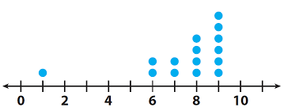
Think, pair and share.
What is the outlier?
How do you think it will affect the mean?
With a partner, calculate the mean with AND without the outlier.
IF there is an outlier, which measure of center is more accurate?
Mean
Median

Slide 11
Draw a back to back Stem and leaf diagram to compare the battery life of two mobile phone brands, in your exercise book.
Brand A:
7 10 15 15 17 17 19 20 22 22
26 27 30 32 34 36 38 56 75
Brand B:
5 7 8 8 10 11 14 17 19 21
22 22 22 22 30 32 34 36 38

Slide 12
Comparing the battery life
Which brand is better? – justify
(extension, identify the outlier and its affect on the mean in your justification)
Finish MMMR practice sheet from today and yesterday.

